Slide 1

Helly, Hahn-Banach analytic form

Slide 2
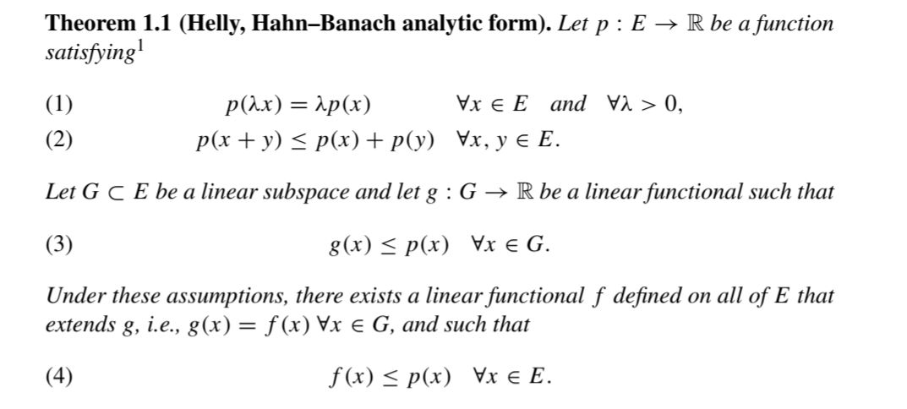

Slide 3


Slide 4


Slide 5


Slide 6


Slide 7



Slide 8
